Slide 1

Project Name :
Customer Retention

Slide 2
Problem Statement :
Customer satisfaction has emerged as one of the most important factors that guarantee the success of online store; it has been posited as a key stimulant of purchase, repurchase intentions and customer loyalty. A comprehensive review of the literature, theories and models have been carried out to propose the models for customer activation and customer retention. Five major factors that contributed to the success of an e-commerce store have been identified as: service quality, system quality, information quality, trust and net benefit. The research furthermore investigated the factors that influence the online customers repeat purchase intention. The combination of both utilitarian value and hedonistic values are needed to affect the repeat purchase intention (loyalty) positively. The data is collected from the Indian online shoppers. Results indicate the e-retail success factors, which are very much critical for customer satisfaction.

Slide 3
What is Customer Retention?
The customer retention is the process of engaging existing customers to continue buying products or services from their business. The goal of customer retention is retaining as many as customer as possible in the company.
Why is Customer Retention Important?
Customer retention is an express route to a business’ financial success. It allows the companies
to build long term, meaningful relationships with customers.
It empowers customers to share feedback with the company team.
It helps you understand how loyal and satisfied your customersare, how strong your customer service is, and your products arereally worth their money or not.
It enhances the brand reputation and understands future needsof the customers.

Slide 4
Data Analysis Steps Done :
Import Libraries
Import Dataset
Data Preprocessing
Finding null values
Visualization(EDA)
Bivariate Analysis
Conclusion
Univariate Analysis:

Slide 5
Exploratory Data Analysis (EDA) Steps :
1.Checking the missing values
2.Checking for numerical columns
3.Checking for the distribution of numerical variables
4.Checking for Categorical variables
5.Types of categorical variables
6.detecting outliers
Checking the missing value Missing values :
Observation:- There are no missing values present in the dataset
Checking the numerical columns :
There are 1 numerical values present in the dataset

Slide 6
Checking the categorical variable :
Observation:- There are 71 categorical values present in dataset
Data Visualization :
Univariate Analysis :
We use Univariate Analysis to understand the count and categorial features.
There is 71 columns and there visualizations so I use only important data and also use Bivariate Analysis to show main comparisons for better sanalysis.

Slide 7
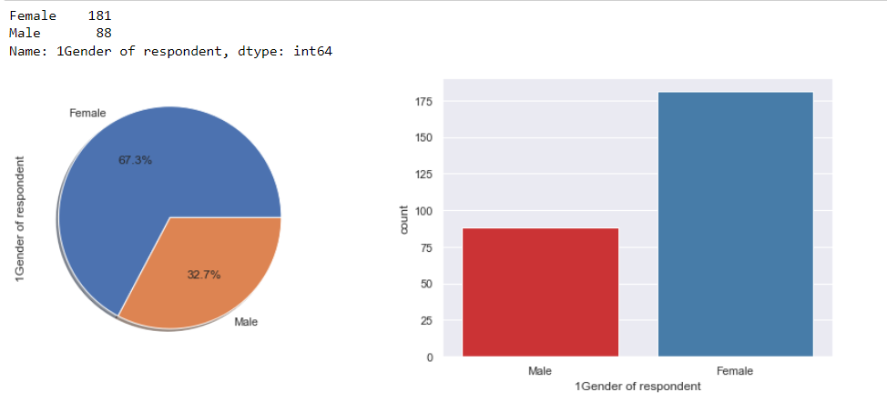
Out of all the customers, that have been asked the several questions, female individuals are more in counts 181(67.3%) than the male individual counts i.e 88

Slide 8
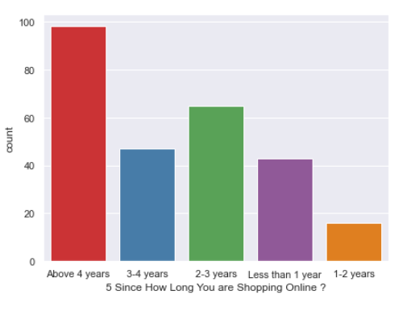
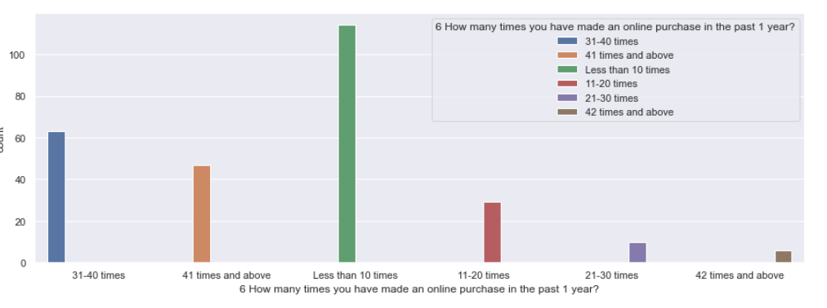
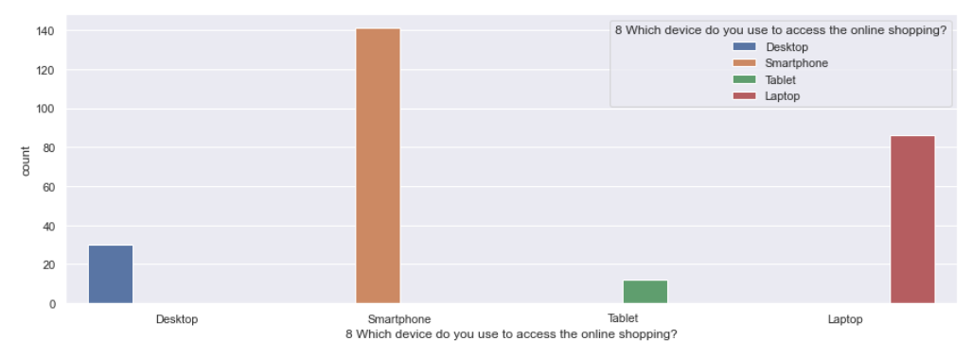
Online shopping activities and preferences :

Slide 9
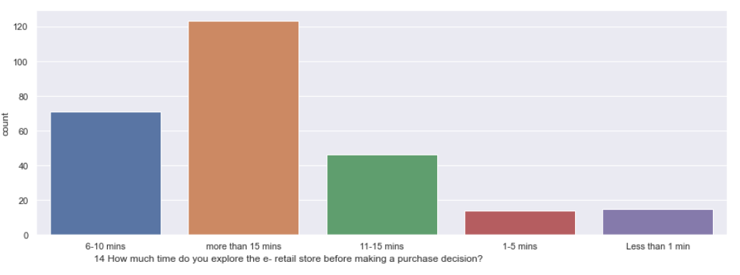
Based on the above graphs it is observed that :
Majority of the consumers have been shopping for over 4 years and have made less than 10 purchases in the last 1 year.
Smartphone and mobile internet are the most popular means of accessing ecommerce websites, with most common screen size being 5.5 inches or greater.
Most consumers spend over 15 mins browsing an e-commerce website before making a purchase decision.

Slide 10
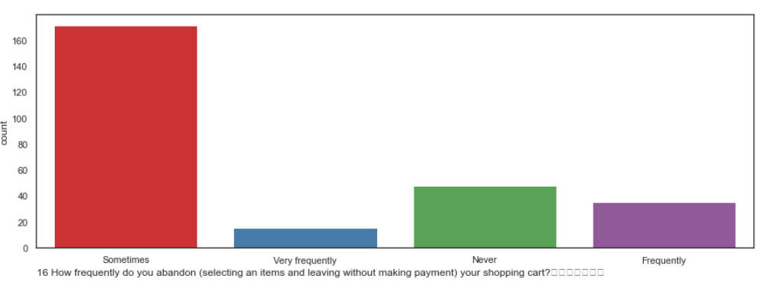
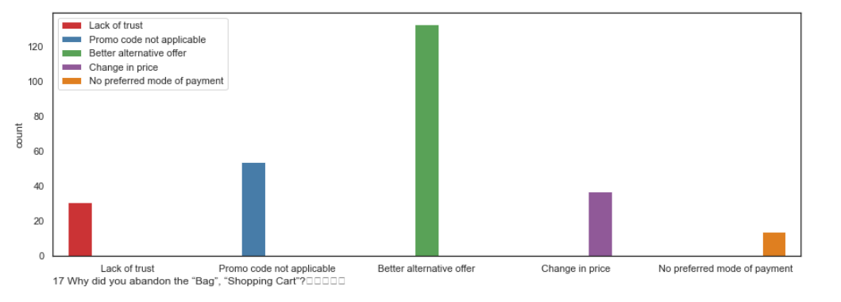
Consumer Hesitation :-

Slide 11
Various factors/reasons which contributed to consumers’ hesitation to complete a purchase online were analysed from the data provided under the columns of the data frame.
Based on the above graphs it is observed that :
Consumers sometimes abandon items in shopping cart.
Finding a better alternative offer is the most common reason behind why consumers abandon items on a particular e commerce website.

Slide 12
Consumer opinions on Website Features :
Analyzing the opinions of the participants on the various features of the e-commerce websites reveals that Majority of the consumers strongly agree that:
The content on the website must be easy to read and understand.
Information on similar product to the one highlighted is important for product comparison.
Complete information on listed seller and product being offered is important for purchase decision.
All relevant information on listed products must be stated clearly.
Navigation in website should be easy.
Loading and processing should be quick.
Interface of the website must be user friendly

Slide 13
Convenient Payment methods should be available.
There is trust in the online retail store fulfilling its part of the transaction at the stipulated time.
There should be Empathy (readiness to assist with queries) towards the customers.
Online retail store should be able to guarantee the privacy of the customer.
There should be Responsiveness, availability of several communication channels (email, online rep, twitter, phone etc.).
Online shopping gives monetary benefit and discounts.
Enjoyment is derived from shopping online
Shopping online is convenient and flexible
Return and replacement policy of the e-tailer is important for purchase decision

Slide 14
Gaining access to loyalty programs is a benefit of shopping online.
Displaying quality Information on the website improves satisfaction of customers.
User derive satisfaction while shopping on a good quality website or application.
Net Benefit is derived from shopping online can lead to users satisfaction.
User satisfaction cannot exist without trust.
E commerce websites must Offer a wide variety of listed product in several category.
There should be Provision of complete and relevant product information .
Monetary savings must be considerable
You feel gratification shopping on your favorite e-tailer.
Shopping on the website helps you fulfill certain roles.

Slide 15
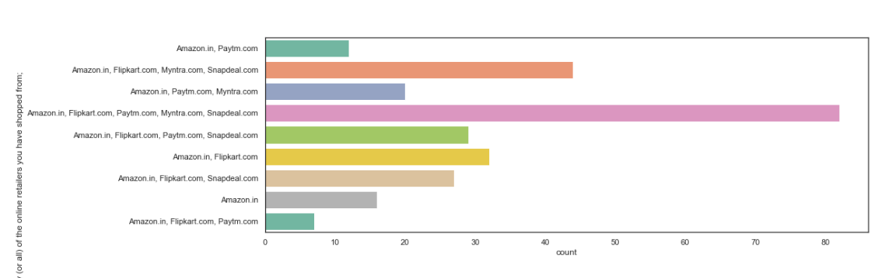
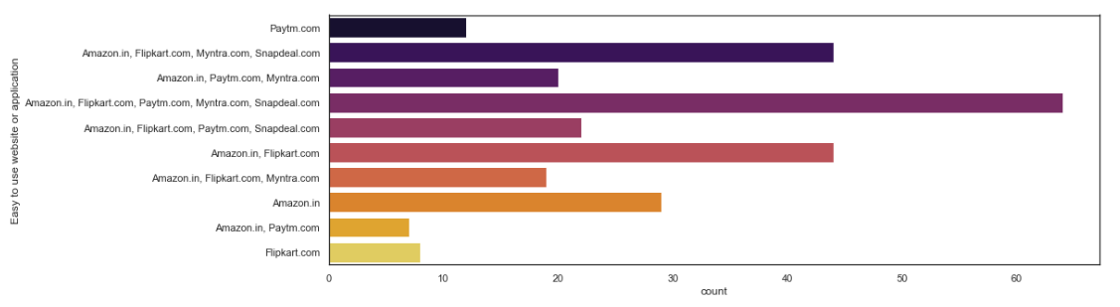
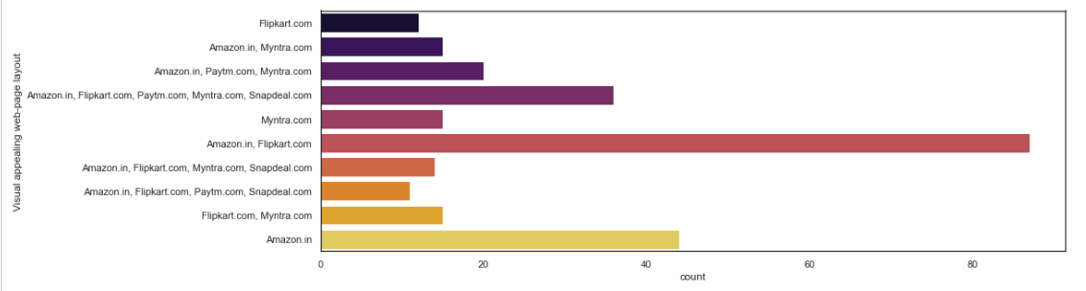
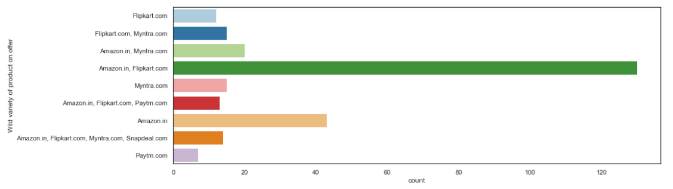
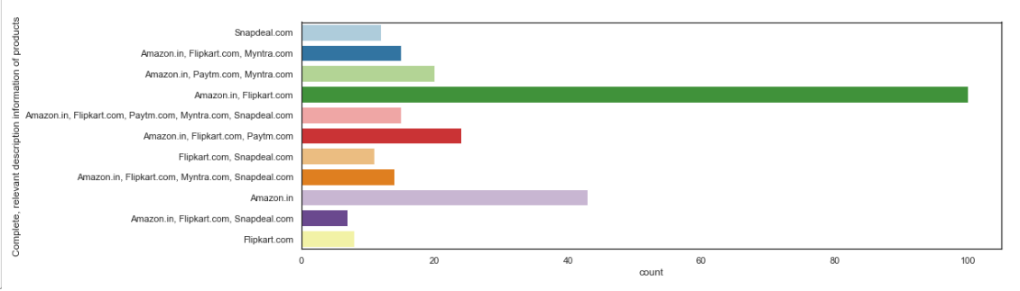
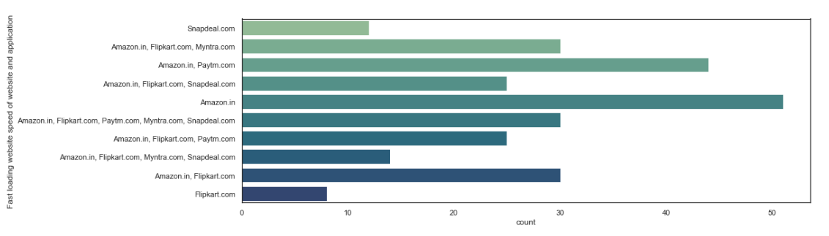
Consumer Ecommerce Website preferences and opinions :-

Slide 16
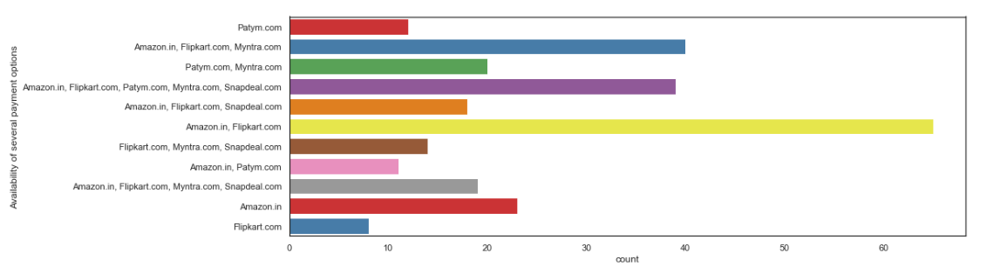
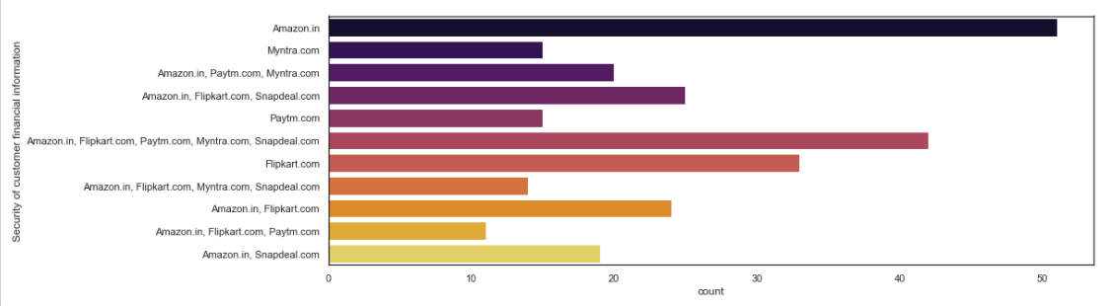
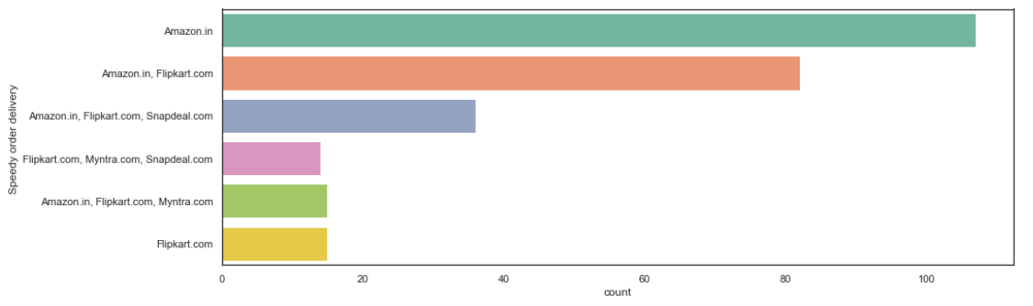
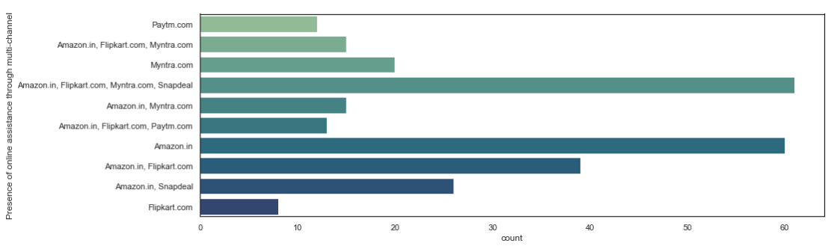
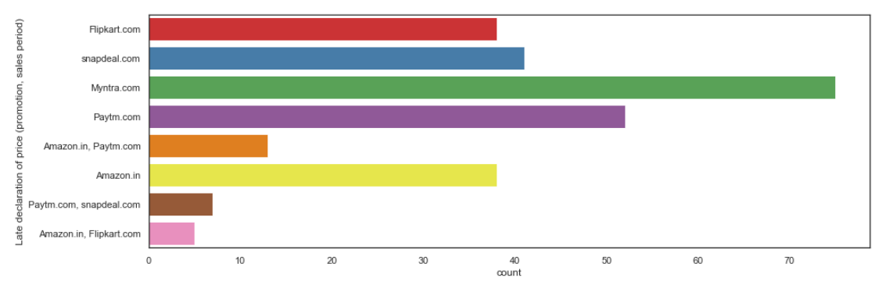
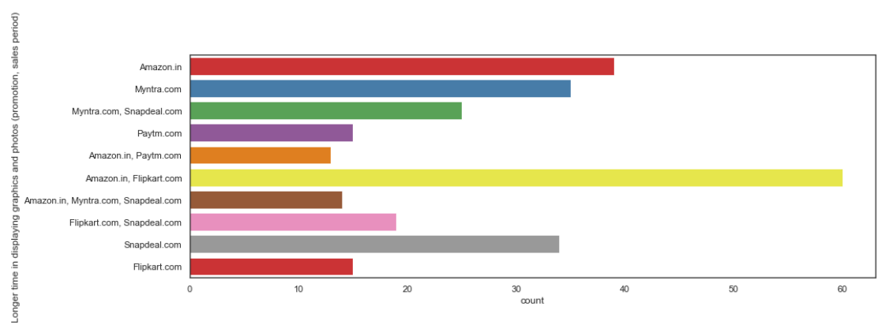

Slide 17
Based on the above graphs it is observed that:
Amazon.in, Flipkart.com, Paytm.com, Myntra.com, Snapdeal.com are the most popular e-commerce websites.
Amazon.in, Flipkart.com, Paytm.com, Myntra.com, Snapdeal.com are the easiest to use websites and applications.
Amazon.in and Flipkart.com have the most visually appealing web-page layout.
Amazon.in and Flipkart.com have the widest variety of products on offer
Amazon.in and Flipkart.com have the most complete, relevant description information of products.
Amazon.in, and Paytm.com have the fastest loading speed while Flipkart is regarded by very few as being quick to load
Amazon.com, Flipkart.com, Paytm.com are considered quick to complete purchases.
Amazon.in, Flipkart.com are regarded by most to have several payment options available

Slide 18
Amazon.in is regarded to offer speedy order delivery by most.
Amazon.in offers the most Privacy for customers’ information.
Amazon.in , followed by Flipkart.com, Paytm.com, Myntra.com, Snapdeal.com provide the best security for customer financial information.
Amazon.in is perceived to be the most trustworthy website by the majority of participants.
Amazon.in, Flipkart.com, Myntra.com, Snapdeal have the highest presence of online assistance through multi-channel.
Most people face longer time to get logged in during promotion, sales period on Amazon.in and Flipkart followed by Paytm and Myntra
Amazon.in, Flipkart.com take the longest time displaying graphics and photos during promotion, sales period.
Most people face Late declaration of price on Myntra and Paytm during promotion, sales period.

Slide 19
Myntra and Paytm take the longest page loading time during promotion, sales period.
Snapdeal.com and Amazon.in have the most limited modes of payment on most products during promotion, sales period.
Paytm.com and Snapdeal.com have Longer delivery periods compared to others.
Amazon.in and Paytm.com have had recent changes in website/Application design, as observed by the consumers.

Slide 20
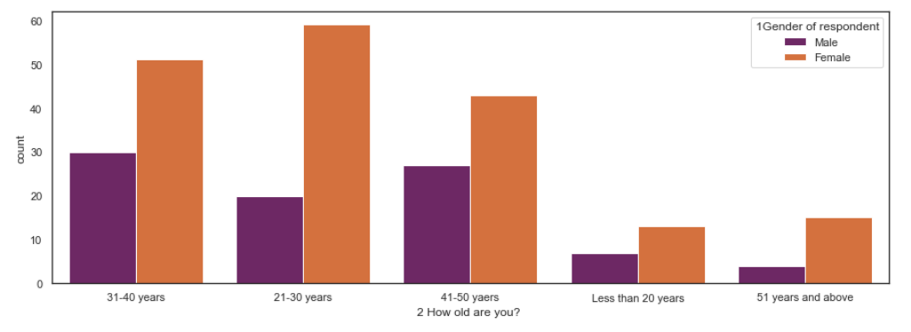
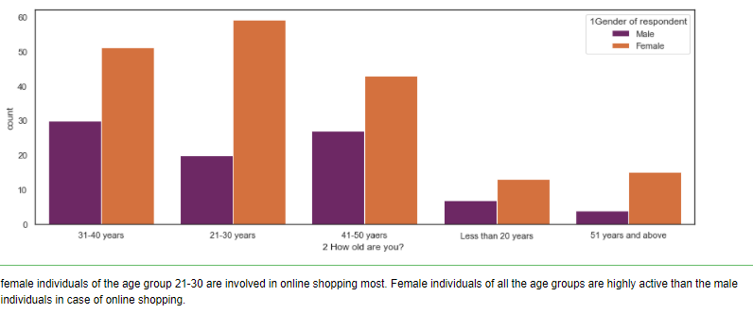
Bivariate Analysis :

Slide 21
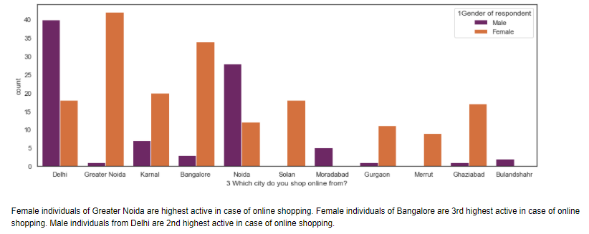
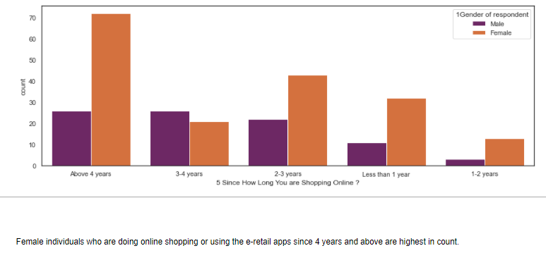

Slide 22
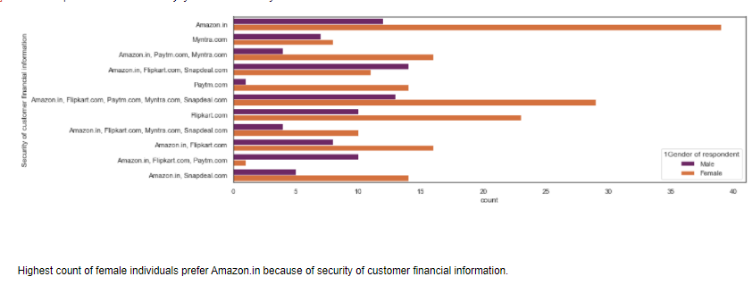
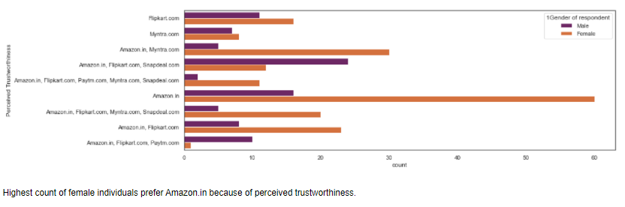

Slide 23
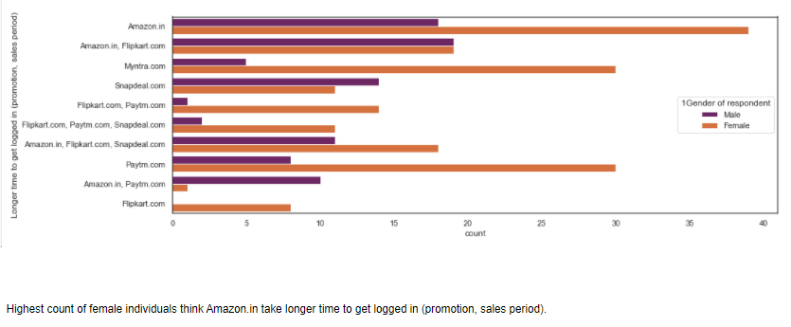

Slide 24
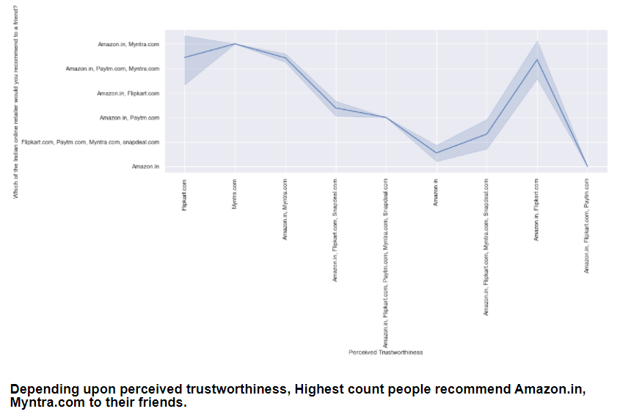

Slide 25
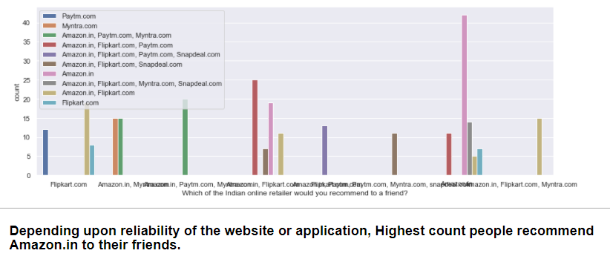

Slide 26
Conclusion :
The dataset provided, had columns in the form of questionnaire that worked more like feedback. It was detailed having various information about many aspects of the customers who are currently shopping from an e-retail sectors. It showed that both male and females are inclined towards e- shopping. It has also shown that online sectors are the creating a boom in the spending habits of the customers and are in turn shaping their habits. Now, the provided dataset is about 269 customers from Delhi, Greater Noida, Noida, Bangalore, Karnal, Solan, Ghaziabad, Gurgaon, Meerut, Moradabad, Blandisher who are asked 71 types of questions regarding e-commerce retail sectors to understand their point of view and experience. and we have analysed all the data thoroughly and closely and for that we can also say that it also serves as a survey of popularity of phones, popularity of web browsers. As per the analysis,

Slide 27
The most preferred website/application is Amazon.in .
The most involved gender, regarding online shopping is Female.
People mostly use smartphones to stop online.
To retain customers, websites should fix their bugs as sometimes during sale the applications get lagged.
The e-retailers should maintain their quality as people are always looking for better options. The analysis also goes on to show gender based inclination towards e-retail sectors. The dataset is particularly interesting as it showcases area based shopping experiences which is a clear reflection of growing digital India.

Slide 28
Submitted By :
Shubham Kathoke
Thank You : )

